Slide 1
High energy QCD at the dawn of the EIC era
Yuri Kovchegov
The Ohio State University

Slide 2
Outline
QCD: a brief introduction
Electron-Ion Collider (EIC): what it will collide and why.
Saturation physics: the high-gluon density regime we would like to find in the nuclear wave functions.
Proton spin puzzle/crisis: can its resolution be at small x?
Conclusions: EIC will help us with both of the above topics.

Slide 3
QCD: a brief introduction

Slide 4
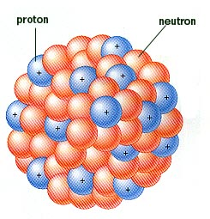
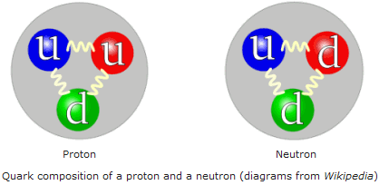
Quantum Chromodynamics (QCD)
QCD is the theory of Strong Interactions.
This is the force that holds quarks together to form protons, and that holds protons and neutrons together to form nuclei.

Slide 5
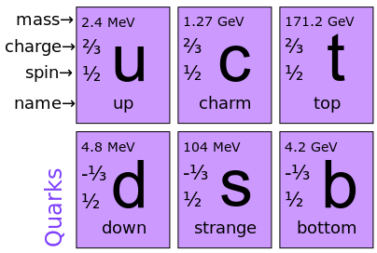
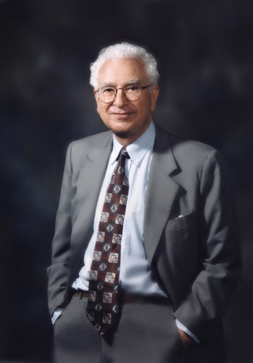
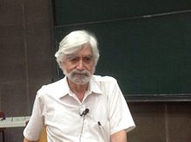
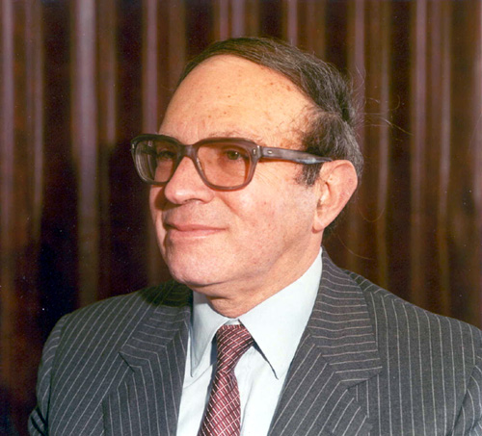
Quarks
QCD describes interactions of
quarks and gluons.
Quarks are spin-1/2 fermions.
They come in 3 “colors” (for example red, blue and green).
They also come in 6 different flavors: up, down, strange, charm, bottom and top.
Quarks were postulated by Murray Gell-Mann, George Zweig and Yuval Ne’eman (early 1960’s):

Slide 6
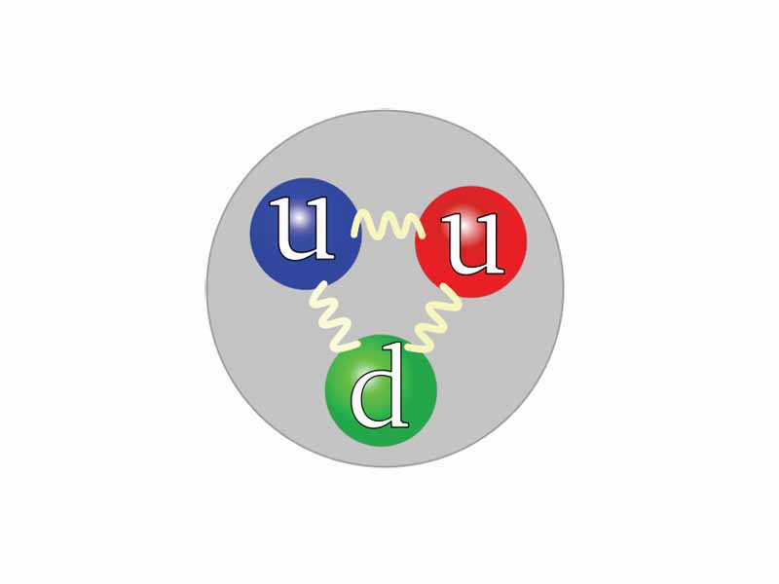
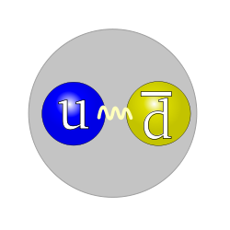
Hadrons
Quarks form colorless states called hadrons:
  Baryons are made out of 3 quarks. (For instance, the proton is made up of two up and one down quarks.)
  Mesons are made out of a quark and an antiquark.
Baryons (proton, neutron, etc)
Mesons (pions, kaons, rho, etc)

Slide 7
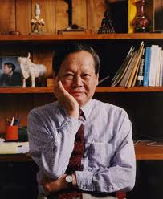
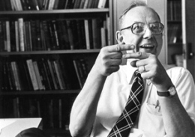
Gluons
Quarks are being held together by gluons.
Gluons are spin-1 massless bosons.
Gluons carry 8 colors – pairwise combinations of quark and antiquark colors (sort of).
Gluons bind quarks together
to form hadrons:
Gluons were postulated by
Chen-Ning Yang
and Robert Mills (1954):
Gluons

Slide 8
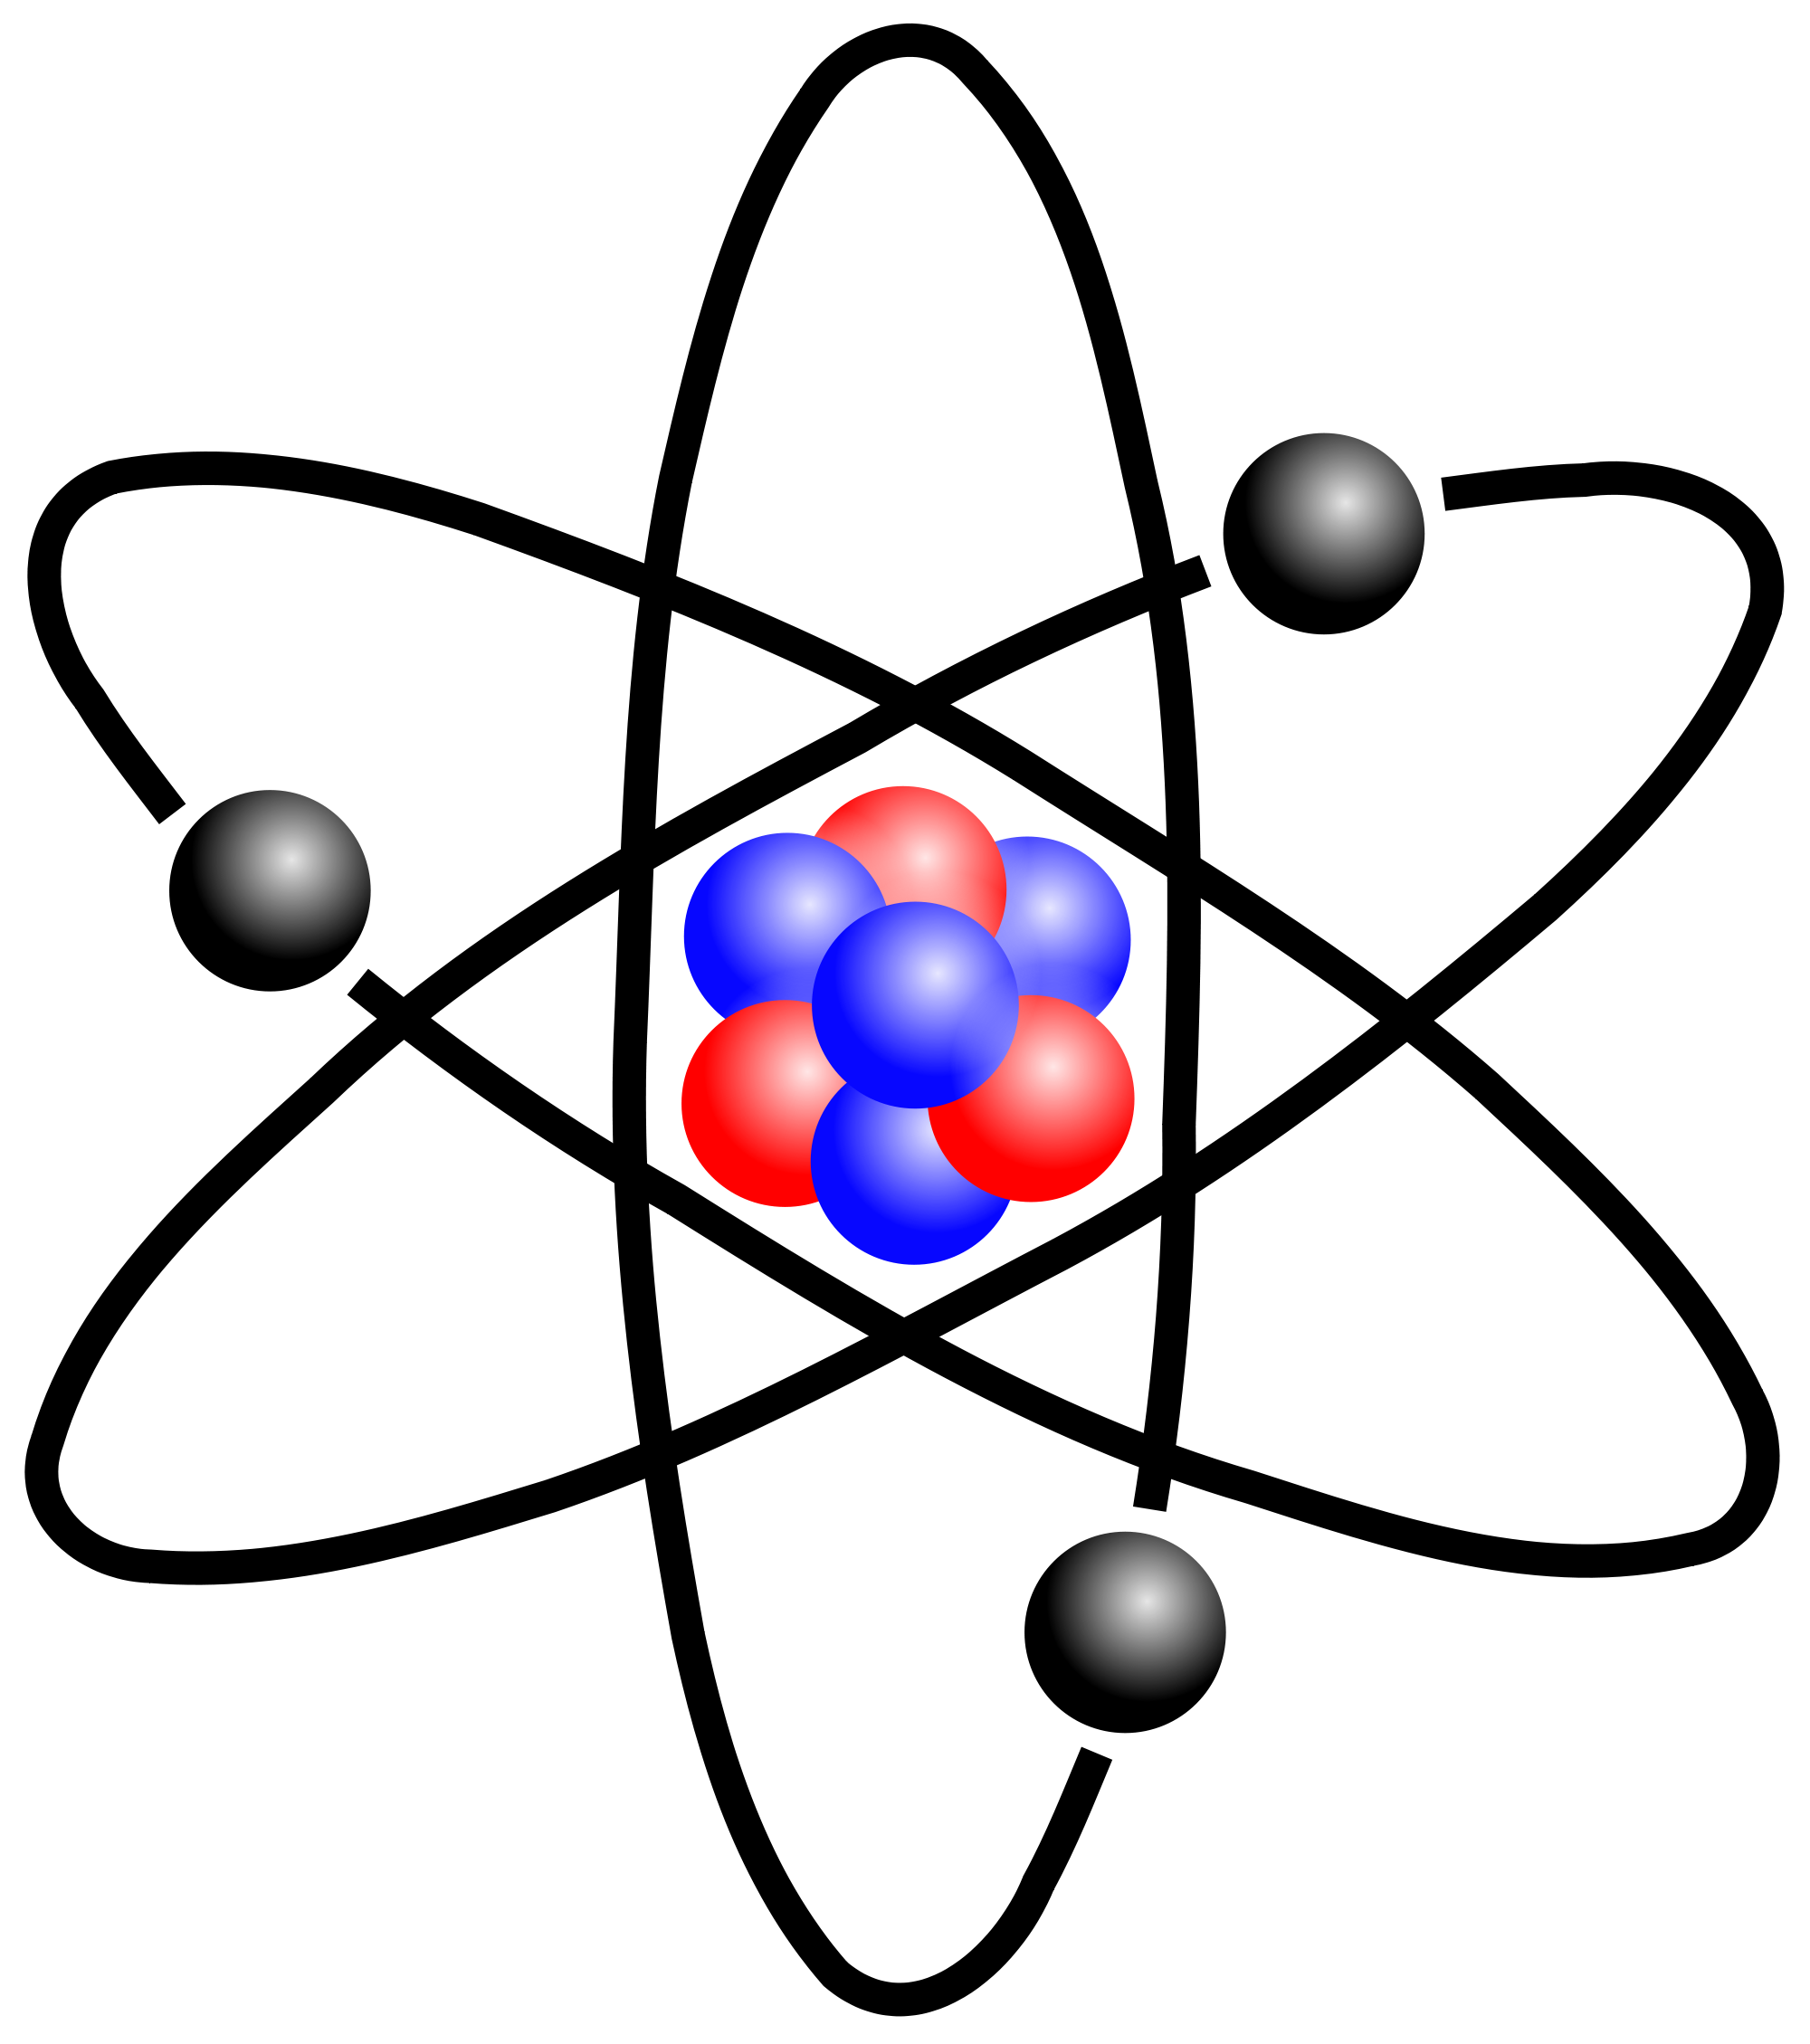
Quantum Electrodynamics (QED)
QED is the theory of Electromagnetic Interactions.
This is the force that holds atoms together.
It describes interactions
of e.g. electrons and protons
in an atom via photon exchanges.

Slide 9
QCD versus QED
How is QCD different from QED? How are strong interactions different from electric? Both have fermions (quarks or electrons) interacting by exchanging bosons (gluons or photons).
Gluons carry color charge, while photons have no electric charge: gluons can interact with each other!

Slide 10
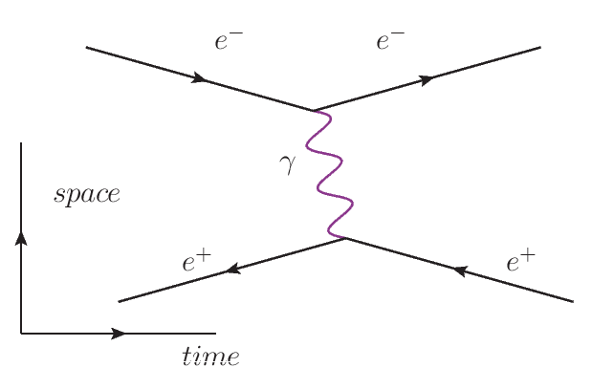
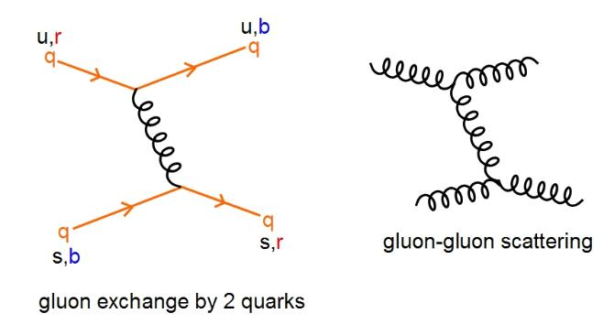
Feynman diagrams
The difference between QCD and QED can be illustrated using Feynman diagrams.
In QED interactions of electrons
are mediated by photons:
In QCD quarks interact by
exchanging gluons. But gluons
can also interact with each other!

Slide 11
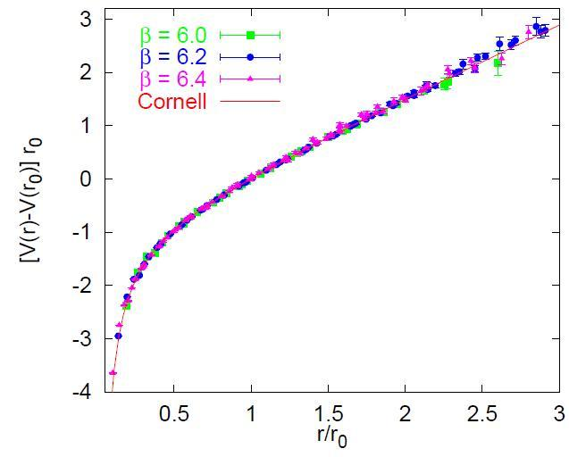

Quark Confinement
The most puzzling property of QCD is quark confinement.
Consider a meson: if you pull quark and anti-quark apart, the potential would increase, $V\left(r\right)\sim r$, and the force will be constant! (Think of a relativistic string.)
Most of the mass of a hadron is
due to the positive potential energy
generated by the interactions leading
to this confining potential!
About 97% of the proton mass comes
from gluon interactions!
Our mass comes from gluons.

Slide 12
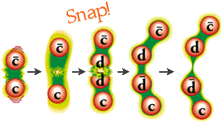
Quark Confinement
Quark is never alone, it is “confined” inside hadrons: if you try to pull one out of the hadron, the “string” snaps, producing a new quark-antiquark pair, with the antiquark forming a new hadron with the quark you pull:
We do not have an analytic understanding of quark
confinement. This is a very profound unsolved problem
(worth $1M from the Clay Institute).

Slide 13
Asymptotic Freedom
QCD is a complicated non-linear theory: quarks and gluons interact with each other, gluons interact with other gluons.
QCD is notoriously hard to deal with: it is very hard to calculate anything in it.
But: in certain limits it simplifies!

Slide 14

Asymptotic Freedom
Apparently at very short distances the interactions between quarks and gluons deep inside the hadrons are weak!
Strength of QCD interactions is measured with the strong coupling constant (a QCD analogue of the fine structure constant). It is related to the color charge g of the quark by
$α_{S}= \frac{g^{2}}{4π}$
This is known as the
Asymptotic Freedom
distance

Slide 15
Asymptotic Freedom
To understand asymptotic freedom think of a point charge in a (dielectric) medium: in QED the medium would screen the charge making it appear smaller.
Vacuum of a field theory is much like a dielectric: electron-positron pairs pop out of the vacuum and screen the charge.
In QCD the gluon pairs actually increase the effective charge with the distance!

Slide 16
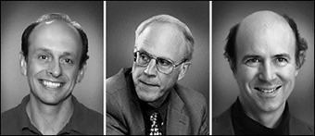
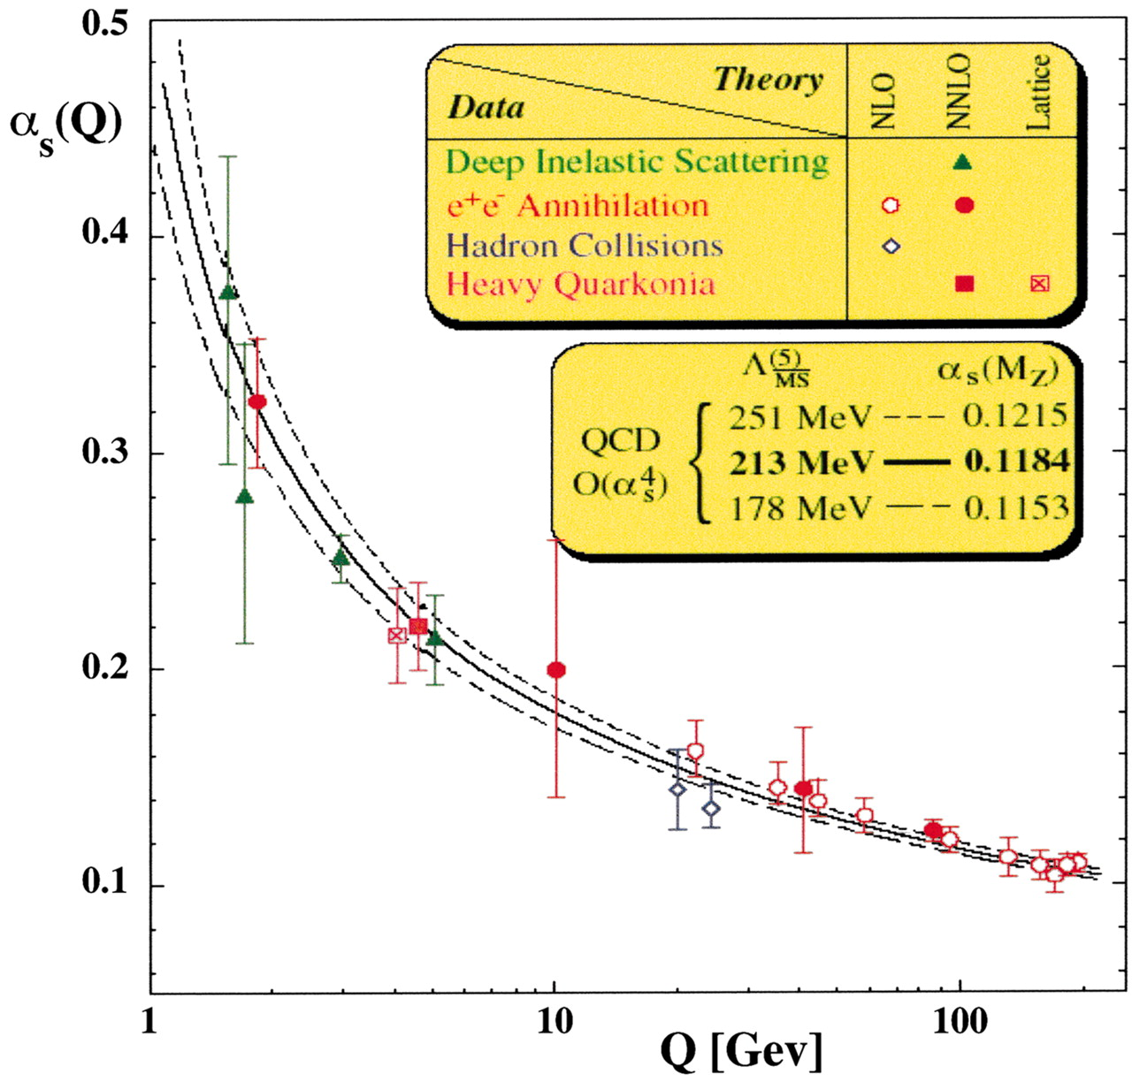

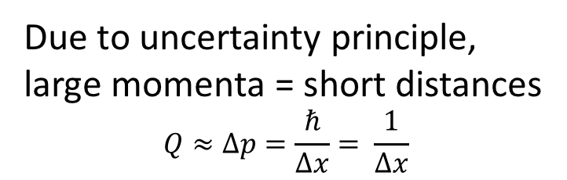
Asymptotic Freedom
Asymptotic freedom was predicted by David Gross (middle), David Politzer (left), and Frank Wilczek (right) in 1973.
Strong interactions are
weak at short distances!
2004 Nobel Prize
Due to uncertainty principle,
large momenta = short distances
$$Q≈∆p=\frac{ℏ}{∆x}= \frac{1}{∆x}$$

Slide 17
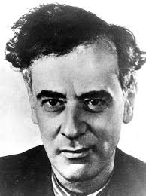
Asymptotic Freedom
“If you are dealing with a problem, first try hard to solve it exactly. If that fails, find a small parameter and expand everything in the powers of that parameter.”
L.D. Landau
(the point is due to Landau,
the wording is mine)
In QCD the strong coupling becomes a small parameter
at short distances and we can follow Landau and construct a series of approximations known as the perturbation series.

Slide 18
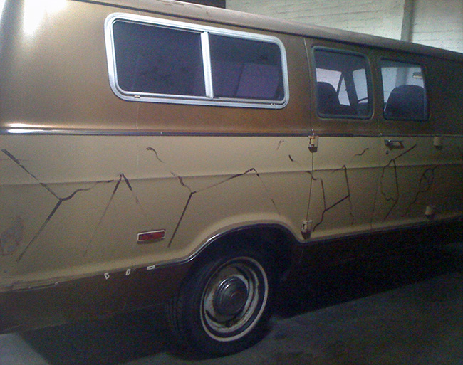
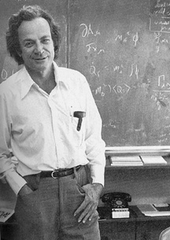
Feynman Diagrams
At short distances/large momenta QCD is weakly-coupled, the coupling is the “small parameter”, and hence QCD physics can be described by Feynman diagrams:

Slide 19
Electron-Ion Collider (EIC)

Slide 20
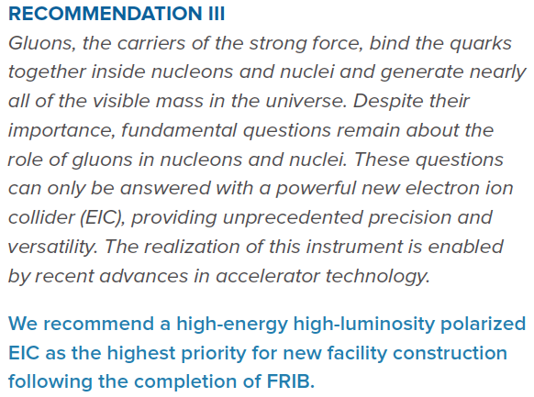

2015 Long Range Plan

Slide 21
Fundamental Questions of QCD
“Cold QCD”: Confinement, chiral symmetry breaking, quantitative understanding of hadron masses, structure of the proton and nuclei.
“Hot QCD”: QCD under extreme conditions: finite-T (heavy ions, Early Universe), finite-μ (neutron stars), high energy QCD asymptotics.

Slide 22
Fundamental Questions of QCD at EIC
“Cold QCD”: Confinement, chiral symmetry breaking, quantitative understanding of hadron masses, structure of the proton and nuclei.
“Hot QCD”: QCD under extreme conditions: finite-T (heavy ions, Early Universe), finite-μ (neutron stars), high energy QCD asymptotics.

Slide 23

Electron-Ion Collider (EIC) White Paper
EIC WP was finished in late 2012 + 2nd edition in 2014
A several-year effort by a 19-member committee + 58 co-authors
arXiv:1212.1701 [nucl-ex]
EIC was approved by DOE in January 2020 and will be built at Brookhaven National Laboratory

Slide 24
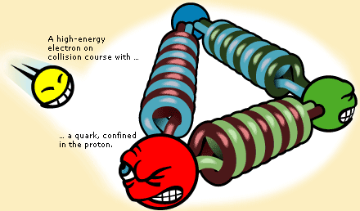
Deep Inelastic Scattering
One can prove the structure of a proton by shooting electrons at it at high energies: this is called Deep Inelastic Scattering (DIS).
e⁻
proton

Slide 25
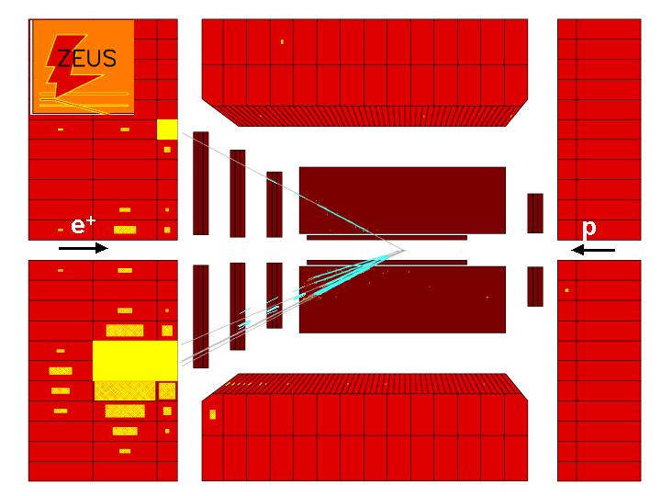
Deep Inelastic Scattering
Here is a typical
deep inelastic
positron-proton
scattering
event.
ZEUS
experiment at
HERA collider,
DESY lab in
Hamburg,
Germany.
⇨
e
e ⇨
⇨
p

Slide 26
Kinematics of DIS
Photon carries 4-momentum , its virtuality is
Photon hits a quark in the proton carrying momentum
with p being the proton’s momentum. Parameter is
the Bjorken x variable.

Slide 27
Physical Meaning of Q
Uncertainty principle teaches us
that
which means that the photon
probes the proton at the
distances of the order (ħ=1)
Large Momentum Q = Short Distances Probed

Slide 28
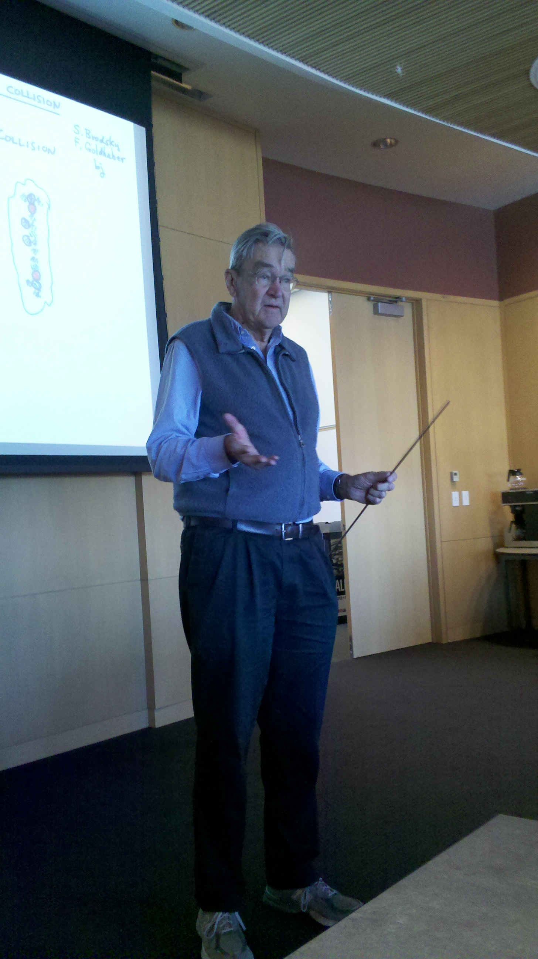
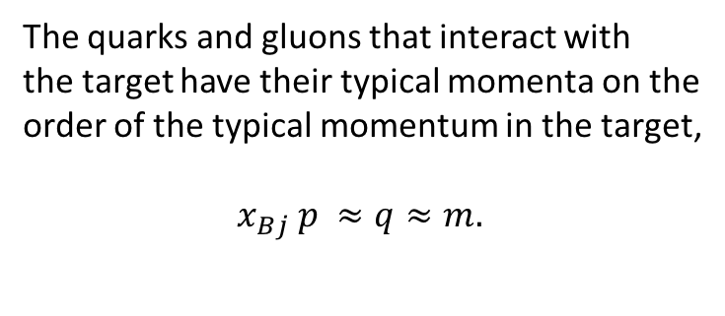
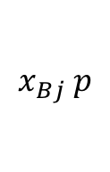

Physical Meaning of Bjorken x
The quarks and gluons that interact with
the target have their typical momenta on the
order of the typical momentum in the target,
${ x}_{Bj} p ≈q≈m.$
$$p$$
proton
$$x_{Bj} p$$
Then the energy of the collision
target
at rest
High Energy = Small x

Slide 29
Physics of High Parton Densities and Gluon Saturation

Slide 30
Gluons at Small-x
There is a large number of small-x gluons (and quarks) in a proton:
G(x, Q²) , q(x, Q²) = gluon and quark number densities (q=u,d, or S for sea).

Slide 31
Gluons and Quarks in the Proton
There is a huge number of quarks, anti-quarks
and gluons at small-x !
How do we reconcile this result with the picture of the proton made up of three valence quarks?
Qualitatively we understand that these extra quarks and gluons are emitted by the original three valence quarks in the proton.

Slide 32
BFKL Equation
Balitsky, Fadin, Kuraev, Lipatov ‘78
Start with N gluons in the proton’s wave function. As we increase
the energy a new gluon can be emitted by either one of the N
gluons. The number of newly emitted particles is proportional to N.
a new gluon is emitted as energy increases
N gluons
it can be emitted off of any of the N gluons
The BFKL equation for the number of gluons N reads:

Slide 33
BFKL Equation as a High Density Machine
As energy increases BFKL evolution produces more gluons, roughly of the same size. The gluons overlap each other creating areas of very high density.
Number density of gluons, along with corresponding cross sections grows as a power of 1/x or, equivalently, of energy (s)

Slide 34
BFKL Equation as a High Density Machine
But can parton densities rise forever? Can gluon fields be infinitely strong? Can the cross sections rise forever?
No! There exists a black disk limit for cross sections, which we know from Quantum Mechanics: for high-energy scattering on a disk of radius R the total cross section is bounded by

Slide 35
Nonlinear Equation
At very high energy gluon recombination becomes important. As energy
(rapidity) increases, gluons not only split into more gluons, but also
recombine. Recombination reduces the number of gluons in the wave function.
Here Y~ln s~ln 1/x is rapidity, s is cms energy squared.
I. Balitsky ’96, Yu. K. ’99 (large N_{c})
beyond large-N_{c}: JIMWLK equation
Number of gluon pairs ~

Slide 36
Nonlinear Equation: Saturation
(DIS)
Black Disk
Limit
Gluon recombination tries to reduce the number of gluons in the wave function. At very high energy recombination begins to compensate gluon splitting. Gluon density reaches a limit and does not grow anymore. Ditto for the total DIS cross sections. Black disk limit is restored!

Slide 37
High Density of Gluons
High number of gluons populates the transverse extent of the proton or nucleus, leading to a very dense saturated wave function known as the Color Glass Condensate (CGC):

Slide 38
Map of High Energy QCD
energy
size of gluons

Slide 39
Map of High Energy QCD
Saturation Scale
grows with energy
energy
BFKL, DGLAP – linear equations
BK/JIMWLK – nonlinear
size of gluons

Slide 40
McLerran-Venugopalan Model
Get A^{1/3} density
enhancement
Large gluon density gives a large momentum scale Q_{s} (the saturation scale): Q_{s}² ~ # gluons per unit transverse area ~ A^{1/3} (nuclear oomph).
For Q_{s} >> Λ_{QCD}, get a theory at weak coupling
and the leading gluon field is classical.

Slide 41
Typical gluon “size”
Number of gluons (gluon TMD)
times the phase space
Most gluons are near
the saturation scale Q_{s}.
Yu.K. ‘96;
Jalilian-Marian et al, ‘97
momentum transverse
to the beam
Gluon “size” = 1/transverse momentum
Typical “size” = 1/Q_{s}

Slide 42
Saturation Scale
To summarize, saturation scale is an increasing function of both energy (1/x) and A:
Gold nucleus provides an enhancement
by 197^{1/3}, which is equivalent to doing
scattering on a proton at 197 times
smaller x / higher s!
This is known as the nuclear “oomph” factor.

Slide 43
Saturation Physics Summary
The nonlinear BK/JIMWLK equations and the MV model lead to a large internal momentum scale Q_{S} which grows with both the decreasing x/ increasing energy s ( ) and the increasing nuclear atomic number A
such that
and we can calculate total cross sections, particle multiplicities, correlations, etc. , from first principles.
Bottom line: coupling is weak, Feynman diagrams work.
But: the system is dense and physics is nonlinear!

Slide 44
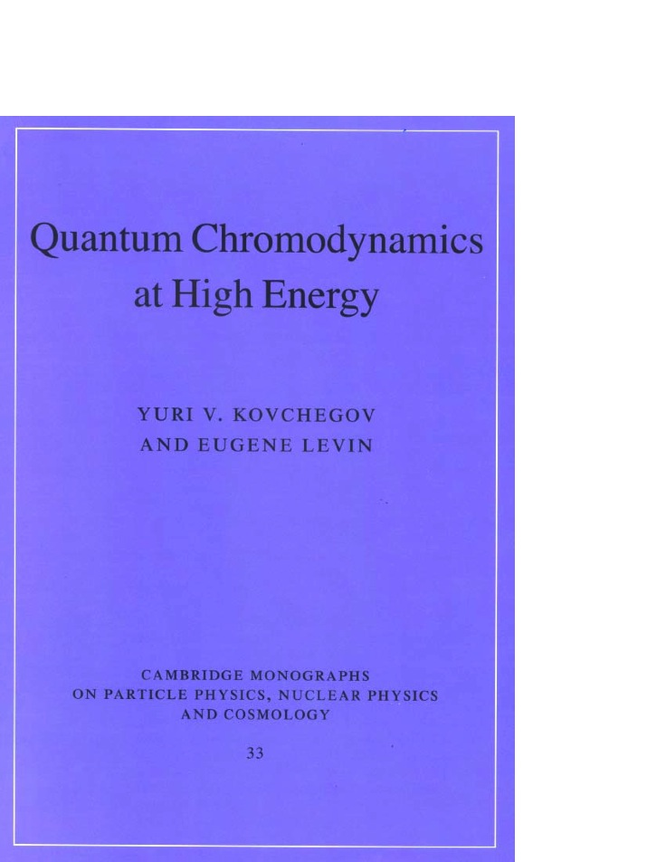
If you want to know more…
Published in September 2012
by Cambridge U Press

Slide 45
Can Saturation be Discovered at EIC?
EIC has an unprecedented small-x reach for DIS on large nuclear targets, allowing
to seal the discovery of saturation physics and study of its properties:

Slide 46
Can Saturation be Discovered at EIC?
EIC has an unprecedented small-x reach for DIS on large nuclear targets, allowing
to seal the discovery of saturation physics and study of its properties:

Slide 47
Proton Spin

Slide 48
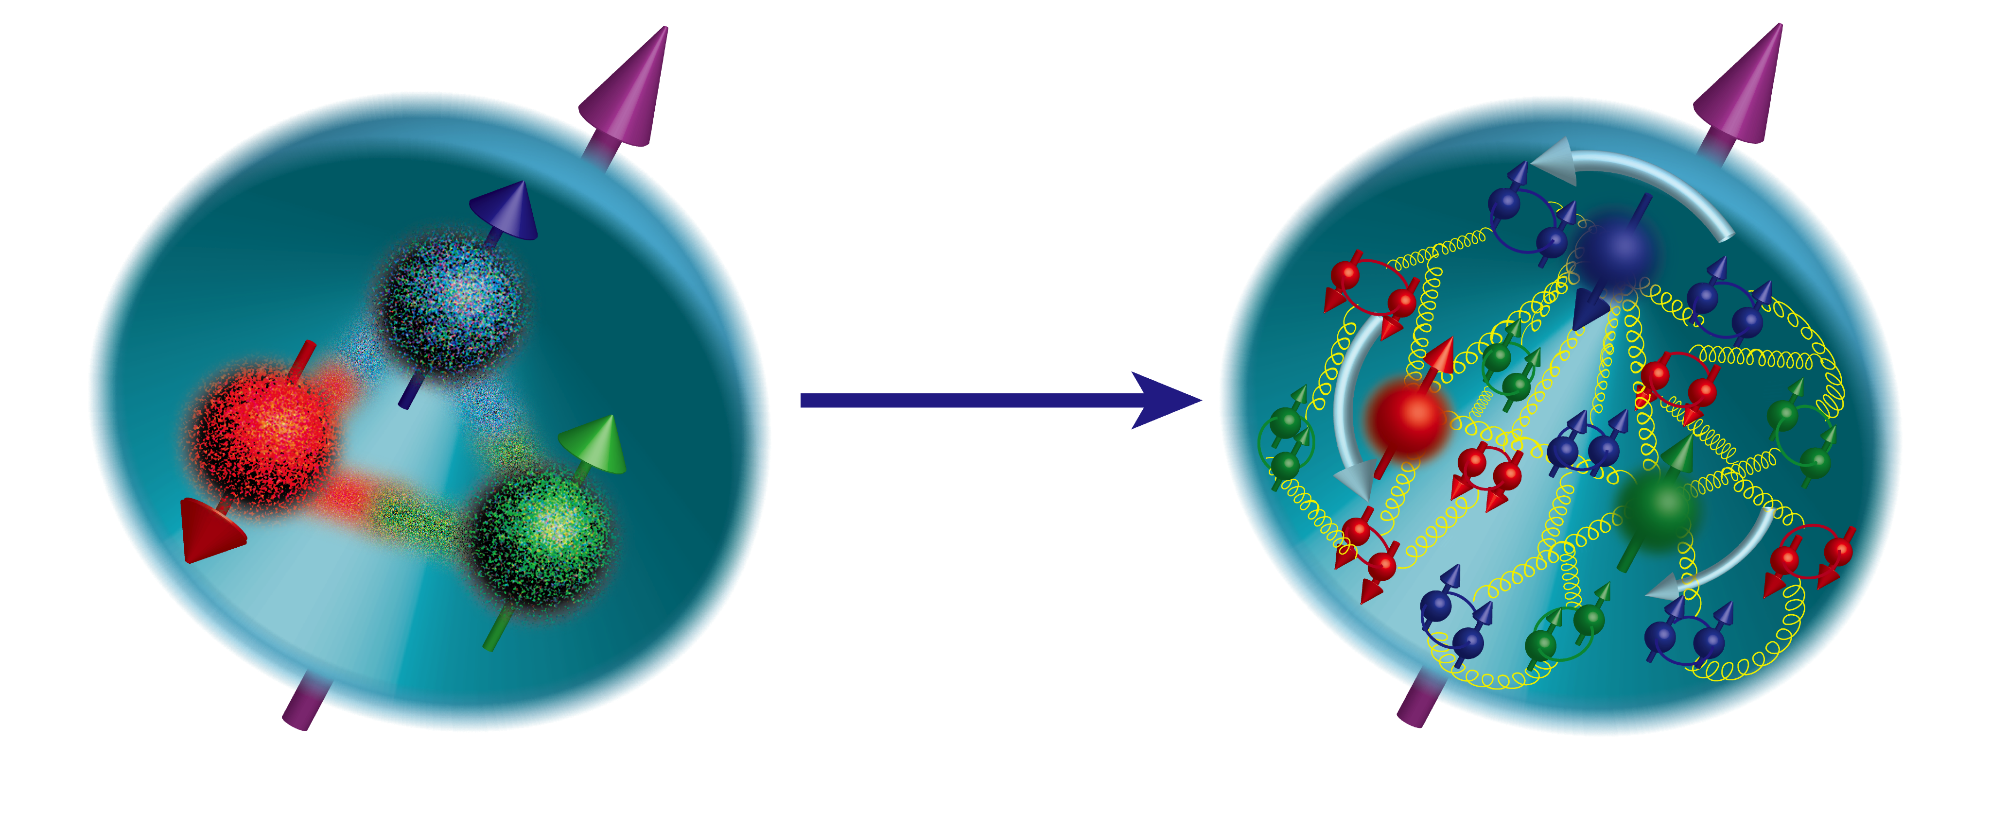
Proton Spin
Our understanding of nucleon spin structure has evolved:
In the 1980’s the proton spin was thought of as a sum of constituent
quark spins (left panel)
Currently we believe that the proton spin is a sum of the spins of valence
and sea quarks and of gluons, along with the orbital angular momenta
of quarks and gluons (right panel)

Slide 49
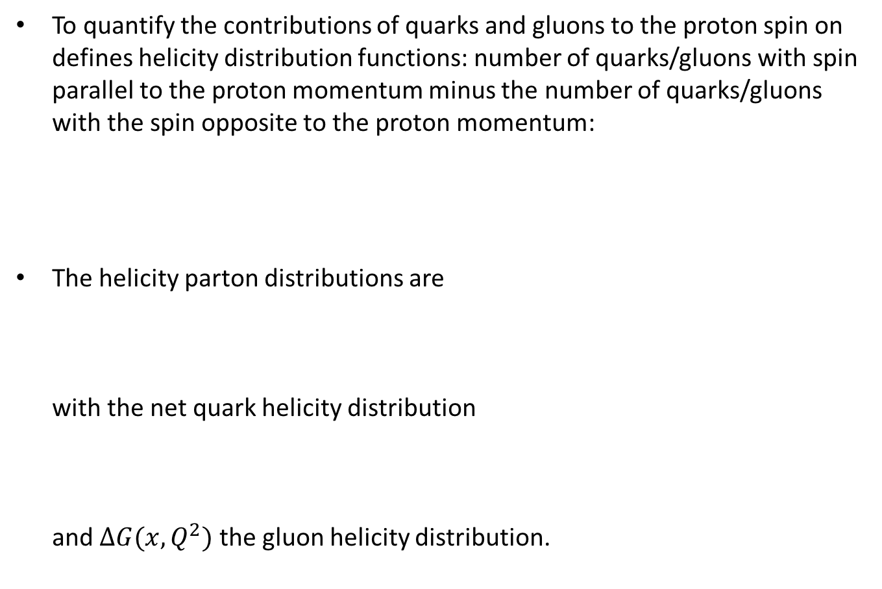
Helicity Distributions
To quantify the contributions of quarks and gluons to the proton spin on defines helicity distribution functions: number of quarks/gluons with spin parallel to the proton momentum minus the number of quarks/gluons with the spin opposite to the proton momentum:
The helicity parton distributions are
with the net quark helicity distribution
and $∆G(x,Q^{2})$ the gluon helicity distribution.

Slide 50
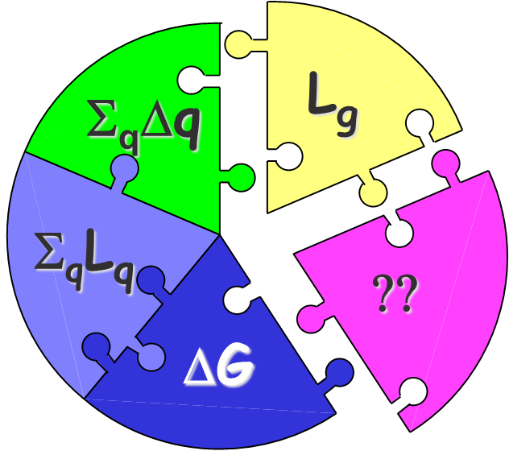
Proton Helicity Sum Rule
Helicity sum rule (Jaffe&Manohar, 1989):
with the net quark and gluon spin
L_{q} and L_{g} are the quark and gluon orbital angular momenta

Slide 51
Proton Spin Puzzle
The spin puzzle began when the EMC collaboration measured the proton g₁ structure function ca 1988. Their data resulted in
It appeared quarks do not carry all of the proton spin
(which would have corresponded to ).
Missing spin can be
  Carried by gluons
  In the orbital angular momenta of quarks and gluons
  At small x:
  Or all of the above!
Can’t integrate down to zero, use x_{min} instead!

Slide 52
Current Knowledge of Proton Spin
The proton spin carried by the quarks is estimated to be
(for )
The proton spin carried by the gluons is (for )
Unfortunately the uncertainties are large. Note also that the x-ranges are limited, with more spin (positive or negative) possible at small x.

Slide 53
How much spin is at small x?
E. Aschenaur et al, arXiv:1509.06489 [hep-ph], (DSSV = de Florian, Sassot, Stratmann, Vogelsang, helicity PDF parametrization)
Uncertainties are very large at small x! (EIC may reduce them.)

Slide 54
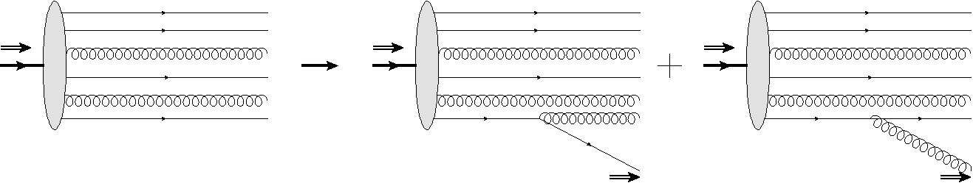
Helicity Evolution at Small x
To understand how much of the proton’s spin is at small x one can construct a helicity analogue of the BFKL equation:
This new helicity evolution equation is a bit more subtle, since it has to keep track of both quark and gluon helicities.
(BFKL/BK/JIMWLK only have gluons at leading order.)
polarized
proton
polarized
quark
polarized
gluon
D. Pitonyak, M. Sievert, Yu.K. ‘15-’18

Slide 55
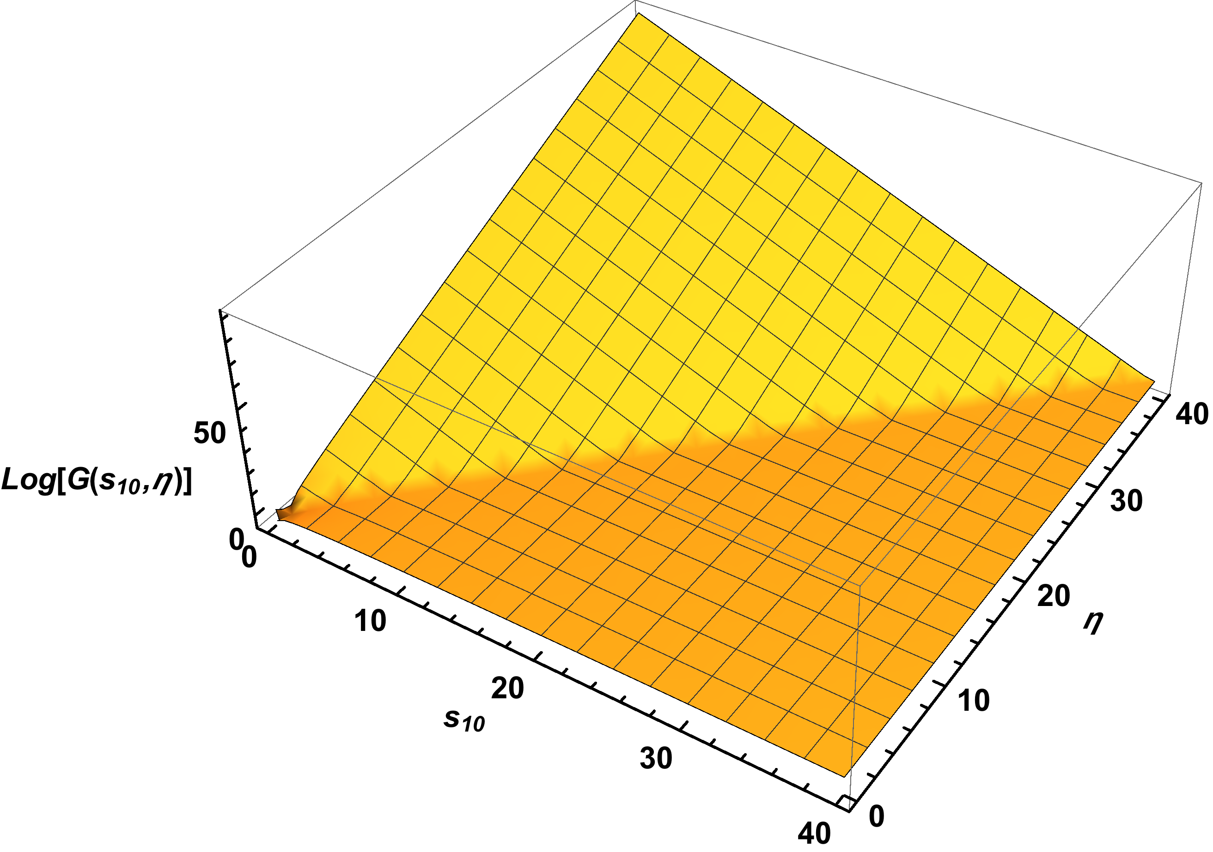
Solution of the Helicity Evolution Equations
The resulting small-x asymptotics for
quark helicity distribution is
quark
helicity
rapidity
(~log of energy)
transverse momentum
scale
D. Pitonyak, M. Sievert, Yu.K. ‘16-’17

Slide 56
Impact on proton spin
We have attached a curve to the existing hPDF’s fits at some ad hoc small value of x labeled x₀ :
Existing helicity PDF
parametrization,
DSSV = de Florian, Sassot,
Stratmann, Vogelsang
(2014)
“ballpark”
phenomenology

Slide 57
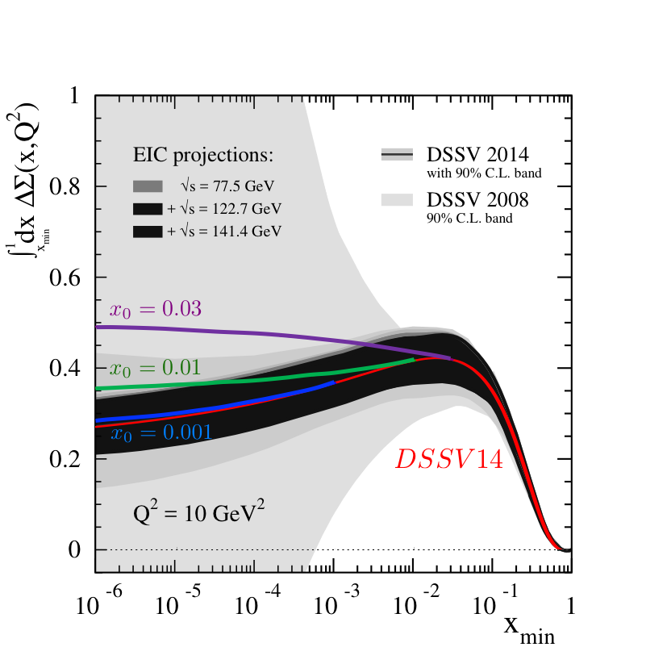
Impact on proton spin
Here we compare our results for the total
quark helicity with DSSV, now including
their error band.
We observe consistency of our lower two
curves with DSSV.
Our upper curve disagrees with DSSV,
but agrees with NNPDF
(Nocera, Santopinto, ‘16).
Better phenomenology is needed. EIC would
definitely play a role.

Slide 58
EIC & Spin Puzzle
Parton helicity distributions are sensitive to low-x physics.
EIC would have an unprecedented low-x reach for a polarized DIS experiment, allowing to pinpoint the values of quark and gluon contributions to proton’s spin:
ΔG and ΔΣ are integrated over x in the 0.001 < x < 1 interval.

Slide 59
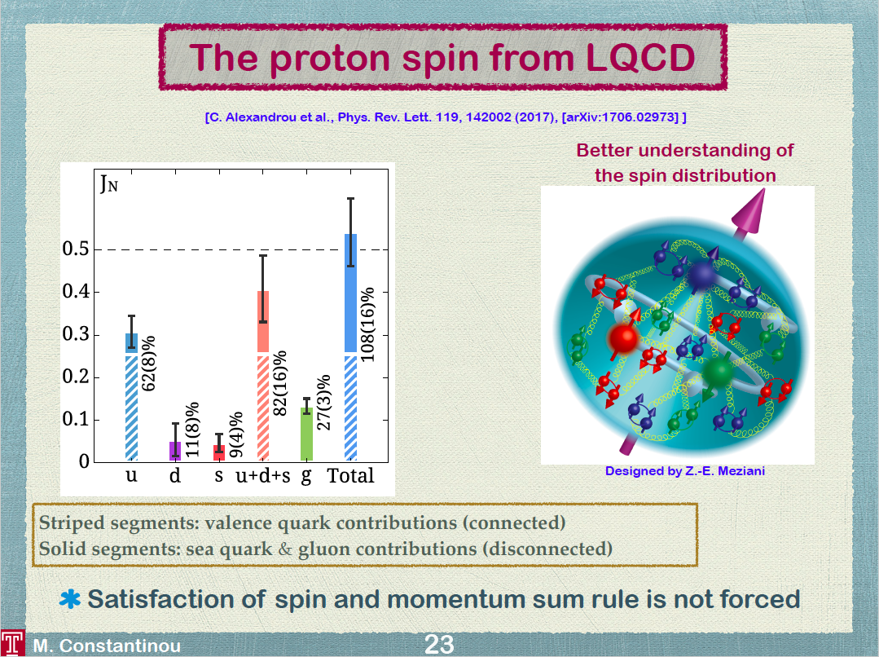
ETMC collaboration, J = L+S
INT EIC program

Slide 60
Conclusions
In recent decades we have seen a lot of progress in our understanding of QCD in high energy collisions.
Non-linear small-x evolution equations have been derived, and used for a lot of successful phenomenology possibly providing evidence for gluon saturation.
The proton spin puzzle appears to be nearing resolution, with a non-zero gluon spin component recently measured at RHIC, lattice QCD achieving high precision, and theoretical developments on spin at small-x promising a handle on the quark and gluon polarizations in that region.
EIC will be able to address both of these important issues:
  EIC can seal the discovery of saturation
  EIC can resolve the spin puzzle

Slide 61
Backup Slides

Slide 62
Big Questions
EIC Would Address
How are the sea quarks and gluons, and their spins, distributed in space and momentum inside the nucleon?
Where does the saturation of gluon densities set it? What is the dynamics? Is it universal?
How does the nuclear environment affect the distribution of quarks and gluons and their interactions in nuclei?

Slide 63
Nonlinear Evolution at Work
Proton
First partons are produced
overlapping each other, all of them
about the same size.
When some critical density is
reached no more partons of given
size can fit in the wave function.
The proton starts producing smaller
partons to fit them in.
Color Glass Condensate

Slide 64
Map of High Energy QCD
Saturation physics allows us
to study regions of high
parton density in the small
coupling regime, where
calculations are still
under control!
(or p_{T}²)
Transition to saturation region is
characterized by the saturation scale

Slide 65
Saturation Scales at EIC
Model I = MV-inspired dipole model
Model II = running-coupling BK evolution (rcBK)
The difference in Q_{s} values is minimal in the EIC range.
Still theoretical uncertainty remains.

Slide 66
Impact on proton spin
Defining we plot it for x₀=0.03, 0.01, 0.001:
We observe a moderate to significant enhancement of quark spin.
More detailed phenomenology is needed in the future.

Slide 67
Impact of our ΔG on the proton spin
We have attached a curve to the existing hPDF’s fits at some ad hoc small value of x labeled x₀ :
“ballpark”
phenomenology

Slide 68
Impact of our ΔG on the proton spin
Defining we plot it for x₀=0.08, 0.05, 0.001:
We observe a moderate enhancement of gluon spin.
More detailed phenomenology is needed in the future.

Slide 69
EIC: Solving the Spin Puzzle
arXiv:1409.1633
1/2 -
Gluon
-
Quarks
=
orbital angular
momentum
Above plot shows the running integral of ∆g(x,Q²) from x_{min} to 1 as a function of x_{min}
Large reduction in uncertainty on ∆G from EIC can be seen
EIC will also reduce the uncertainty on the quark contribution to the proton spin
Constraints on gluon and quark contributions will provide information on the orbital angular momentum component of proton spin
E. Aschenaur et al, arXiv:1409.1633 [hep-ph]

